Slide 1











How to write a scientific paper?
“Springer Journal Suggester”
www.agrimetsoft.com
https://youtube.com/AgriMetSoft/

Slide 2


Introduction
Slowing career progress
Missing opportunities
Losing your thesis score

Slide 3


What is Springer Journal Suggester?
An academic research tool that provides users to opt for the best-suited journal for their research.
3
Notes:
The Springer Journal Suggester is an academic research tool that provides users to opt for the best-suited journal for their research paper. Springer Journal Suggester is a fluent tool that you can apply easily. You can assign several items that cause you to find an improved list of potential journals. An enhanced list of possible journals can help authors ascertain a core publication for their final manuscript submission.

Slide 4

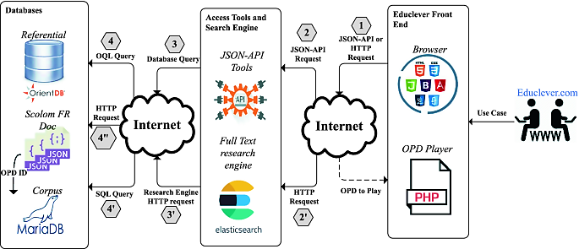

How Does Springer Journal Suggester Work?
web-based semantics technology
4
Notes:
Select the journal that suits your research best from over 2,600 publications.

Slide 5






How Does Springer Journal Suggester Work?
Manuscript title
Manuscript text
Subject area
Impact
Factor
Timeline, Type, etc.

Slide 6

How Does Springer Journal Suggester Work?
6

Slide 7




What are the other publishers?
IEEE
Watch
the next video
Wiley
Taylor

Slide 8





Please subscribe to our channel (https://youtube.com/AgriMetSoft/)
Like & do not forget to share it!!
Put your comments and questions below the video.
www.agrimetsoft.com
https://youtube.com/AgriMetSoft/
Notes:
Please hit the thumbs up button and don’t forget to subscribe !

